Slide 1
TRAIN TICKET RESERVATION SYSTEM
C Programming Project Report
Course Code: CSEG1041
School of Computer Science
University of Petroleum and Energy Studies
Submitted By: Shorya Verma
SAP ID: 590027164
Instructor: Dr. Prashant Trivedi
Date: December 01,2025

Slide 2
Project Overview
The Train Ticket Reservation System is a console-based application developed in C programming language that simulates a real-world.
Railway reservation system . The system manages passengers booking, maintains confirmed and waiting lists, handles cancellation with automatic promotion from waiting list, and generates detailed ticket with completes train information.
This project demonstrates the practical application of fundamental C programming concepts including structures, arrays, enumeration & Modular Programming.
The system provides an efficient solution for managing limited seat availability while maintaining data integrity and user-friendly interaction.

Slide 3
Key Features:
Seat availability checking with real-time updates
Automatic waiting list management
Unique PNR generation
Detailed Ticket printing with ticket information
Automatic promotion from waiting list upon cancellation
Input validation

Slide 4
PROBLEM DEFINITION
The challenge
Railways system needs to:
- Manage limited seating capacity
- Handle multiple booking requests
- Maintain accurate waiting lists
- Process cancellations efficiently
- Generates unique booking identifiers
Our solution
An automated system that:
- Allocates seats intelligently
- Manages FIFO waiting list
- Auto promotes on cancellation
- Stores complete train & passenger info

Slide 5
SYSTEM DESIGN
Enumeration
enum Status { CONFIRMED, wAITING};
Train Structure
typedef struct{
int train_number;
char train_name[50];
char from[30];
char to[30];
char date[15];
} Train;
Passenger Structure
typedef struct {
int pnr;
char name[50];
enum Status status;
Train train_info;
} Passenger;

Slide 6
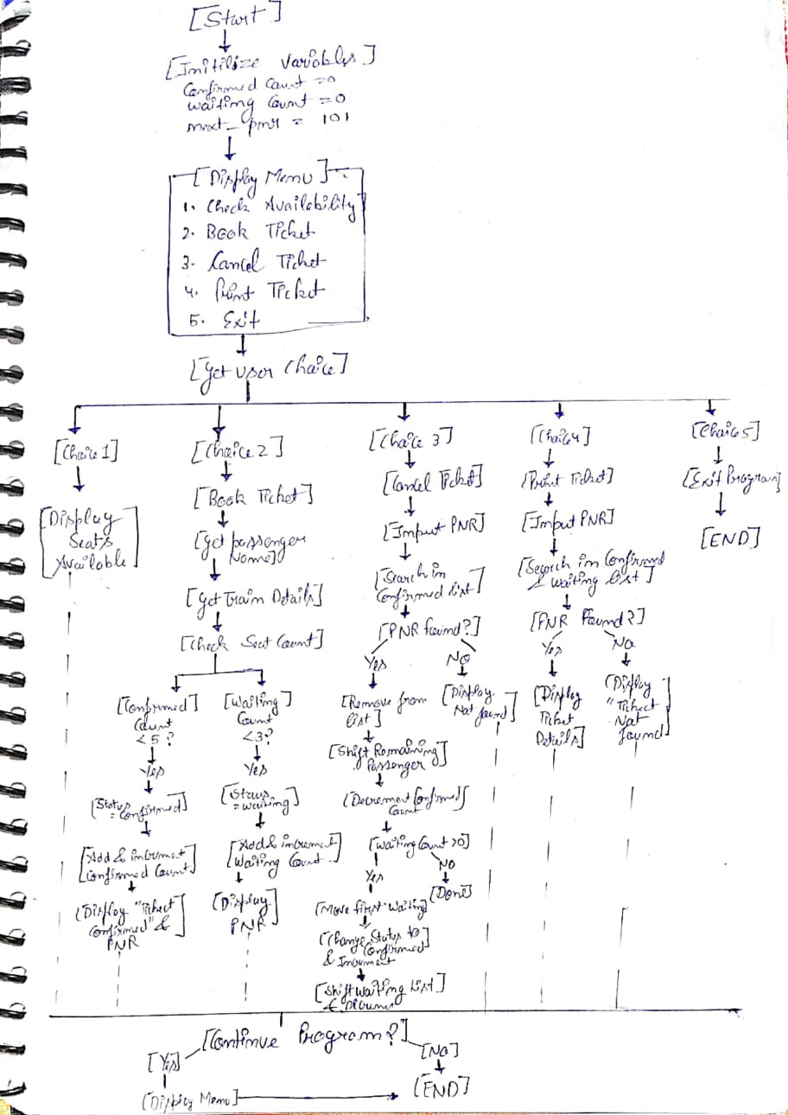
FLOWCHART

Slide 7
Main Algorithm

Slide 8
Algorithms
Booking Algorithm
1.Generate new PNR
2. Get passenger name
3.Get train details (number, name, from, to, date)
IF confirmed seats available THEN
    Add to confirmed list
- Increment confirmedCount
- Display “confirmed” message
  5. ELSE IF waiting list available THEN
    Add to waiting list
- Increment waitingCount
- Display “Waiting” message
  6.ELSE
    Display “No seat available”
  7.Display PNR number
END FUNCTION
Cancellation Algorithm
  Search for PNR in confirmed list
IF found
    - Remove passenger from confirmed list
- Shift remaining passengers forward
- Decrement confirmedCount
- If waiting list not empty THEN
    * Move first waiting passenger to confirmed list
* Update status to CONFIRMED
* Shift remaining waiting passengers
* Decrement waitingCount
* Display promotion message
    END IF
  ELSE
    Display “PNR” not found
END FUNCTION

Slide 9
Implementation

Slide 10
.Functions and its purpose
Function | Purpose
gentrate_pnr() | Genrate unique ID
SeatsAvailable() | Check capacity
Train_details() | Input train info
Book_Tickect() | Book ticket
printfTicket() | Display Ticket
CancelTicket() | Cancel & promote

Slide 11
Technical Challenges & Solution
Challenge 1: Buffer Management
printf("Enter Train Number: ");
scanf("%d", &train->train_number);
getchar();
Problem: scanf() leaves newline in buffer
Solution: Strategic use of getchar() after numeric inputs
Challenge 2: Array shifting
for(int j = i; j < confirmedCount - 1; j++){
confirmed[j] = confirmed[j+1];
}
Problem: Removing elements while maintain order
Solution: Manual shifting with loop

Slide 12
.
Challenge 3: String Input with spaces
fgets(train->train_name, 50, stdin);
train->train_name[strcspn(train->train_name, "\n")] = 0;
Problem: scanf() stops at Whitespaces
Solution: Uses fgets() + strcspn() for cleaning

Slide 13
Testing & Validation
Test Case | Scenario | Result
TC-1 | Normal booking | PASS
TC-2 | Full Capacity -> Waiting | PASS
TC-3 | Complete Full (Reject) | PASS
TC-4 | Print valid ticket | PASS
TC-5 | Cancellation + promotion | PASS
TC-6 | Invalid PNR | PASS

Slide 14
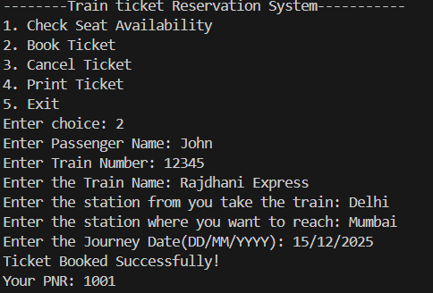
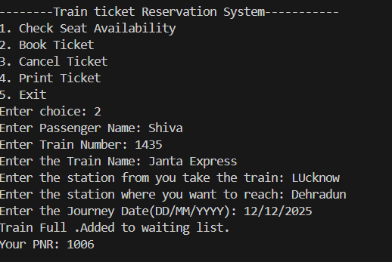
Sample Execution
Normal Booking
Waiting list Scenario

Slide 15
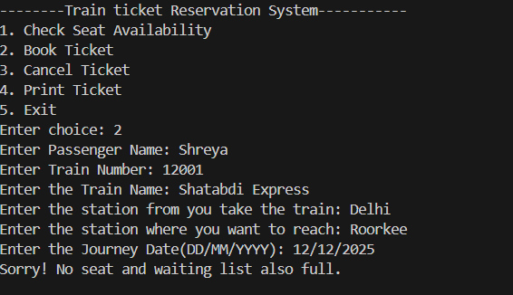
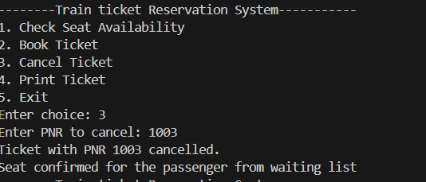
Train Full & waiting list also full after that passenger trying to book the ticket
Cancellation and Promotion

Slide 16
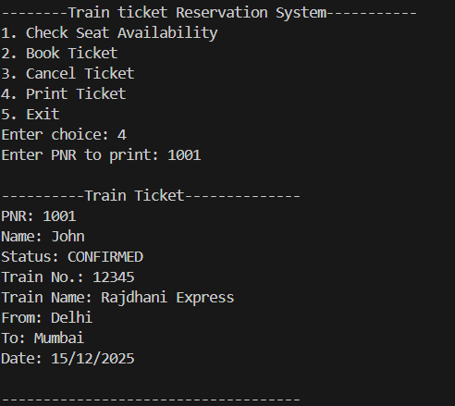
Ticket Printing

Slide 17
Comparison with existing Systems
Our System vs Real World IRCTC
Feature | Our System | IRCTC
Seat Management
Waiting list
Auto Promotion
PNR Generation
Payment
Multiple Trains
Database
GUI

Slide 18
Learning Outcomes
Through this project, I gained hands on experience in:
Designing scalable data structures
Managing memory efficient with fixed size arrays
Handling user input with various C functions
Debugging buffer related issues
Writing modular , maintained code
Testing and validation complex logic flows

Slide 19
Refrences & Resources
C Programming Language (2nd Edition)
Brian W.Kernighan and Dennis M. Ritchie
Prentice Hall,1988
GeeksforGeeks - C Programming
https://www.geeksforgeeks.org/c/c-programming-language/
Indian Railways Reservation System (for domain understanding) https://www.irctc.co.in/nget/train-search

Slide 20
Conclusion
Project Summary
successfully developed a fully functional train reservation system demonstrating:
- Core C programming concepts
- Data structure implementation
- Algorithm design
- Real World problem Solving
Personal Growth
Enhanced understanding of :
- String operation in C
- Modular design principles

Slide 21
Thank You

